Slide 1
Data Analysis
Premier League 2011/2012

Slide 2
Summary
Problematic : How can we determine a specific group of player with data?
I] Introduction
II] My Data
III] Detection

Slide 3
Introduction
What is Data Mining ?
Data Mining is the process of extracting information knowledge from large volume of raw data.
What is RapidMiner ?
« RapidMiner's code-free Modern Analytics platform acceleratesproductivity – from data prep to predictive action. » Rapidminer.com

Slide 4
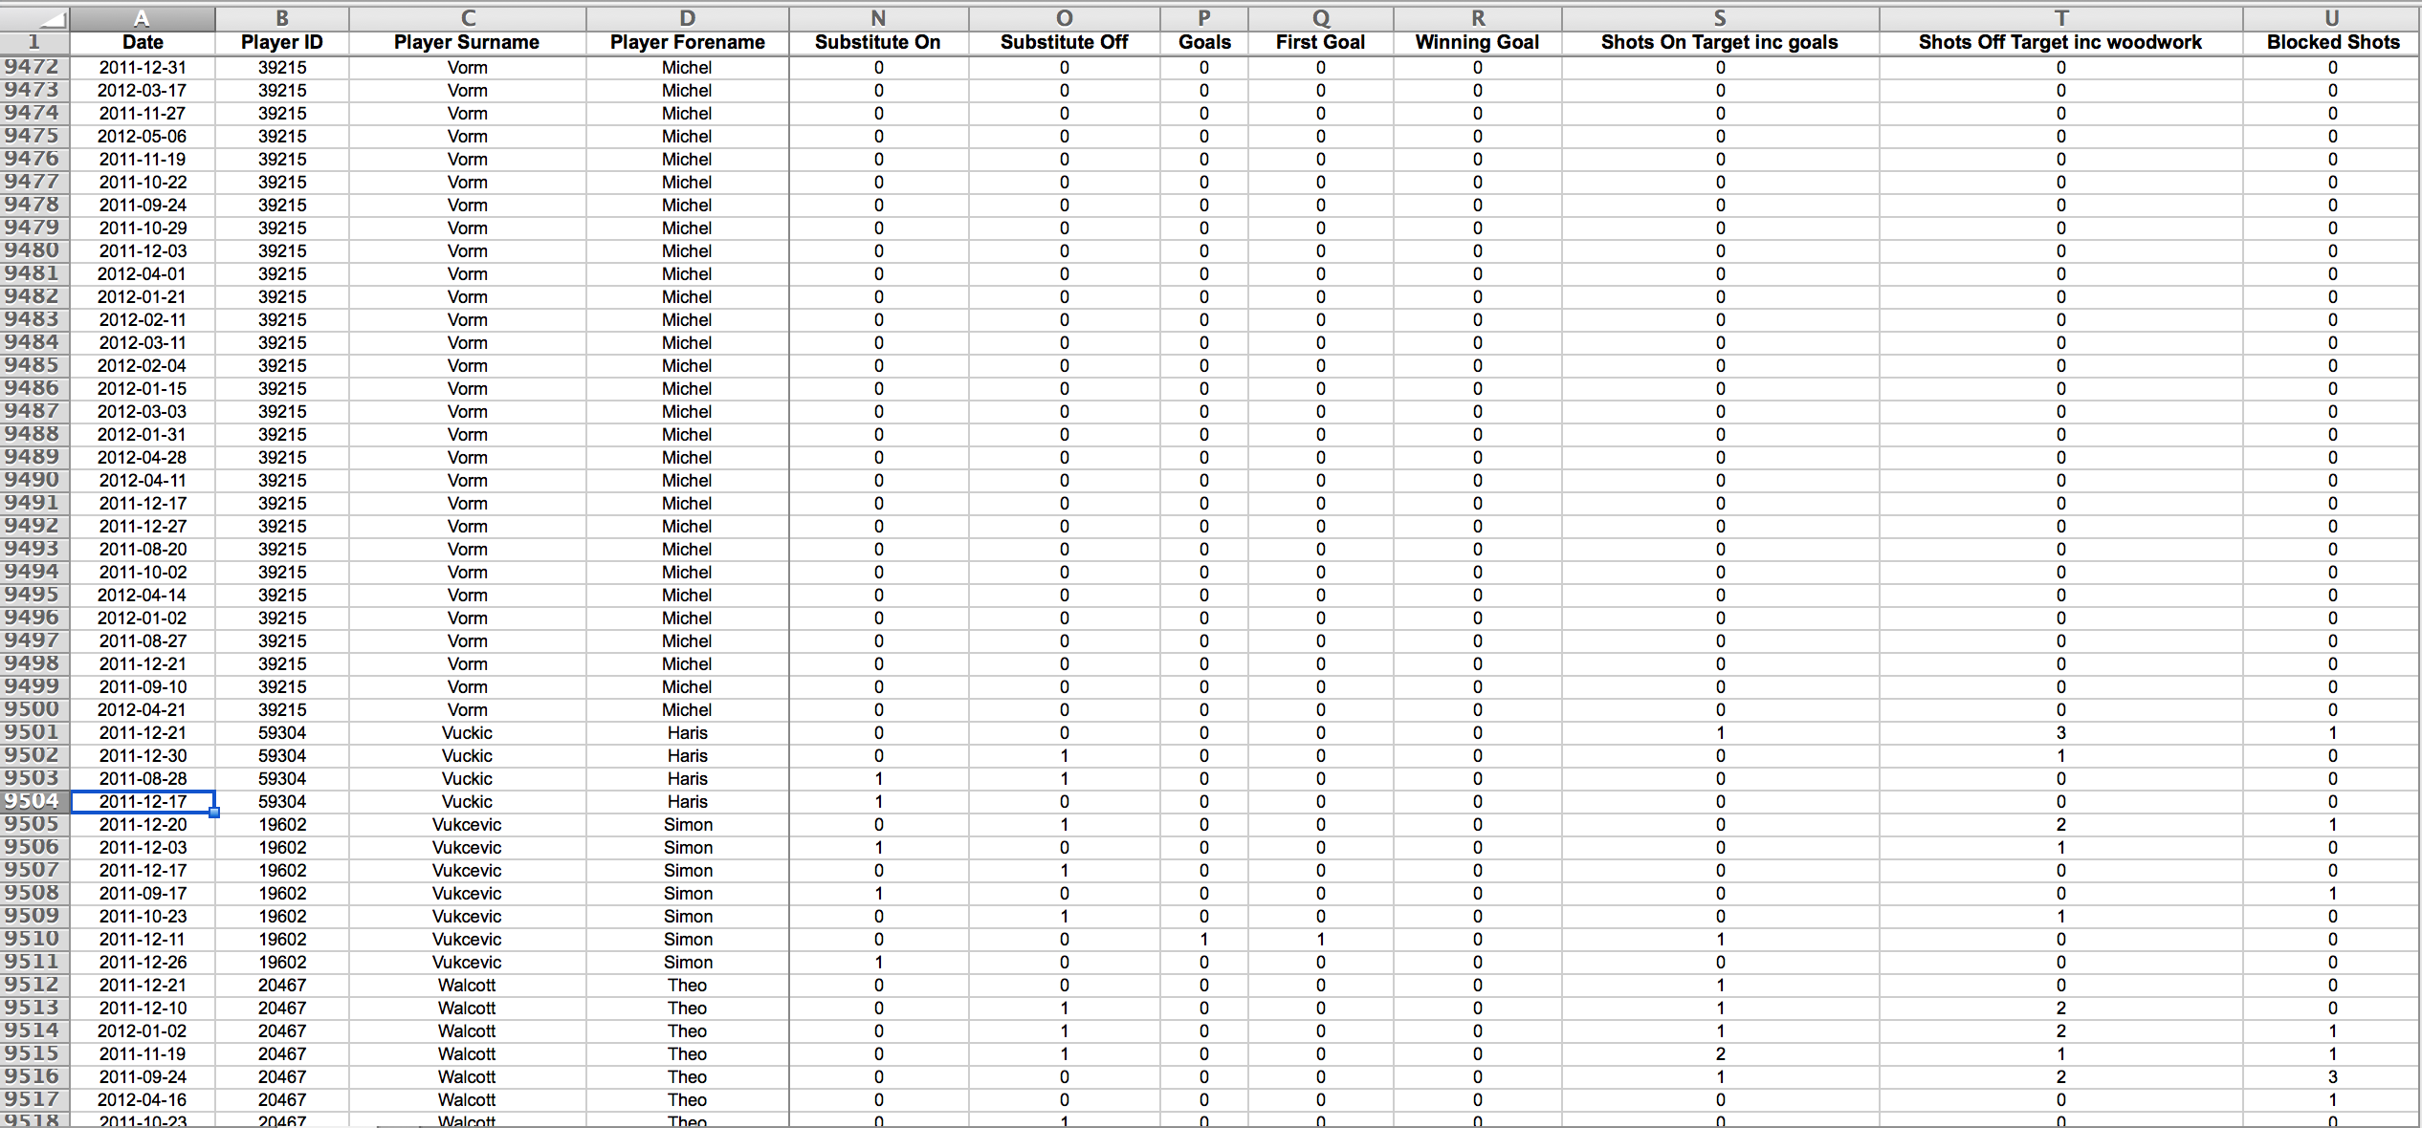
My Data
10370 lines representing each match played by each player
211 column representing different statistics for each player and each match
How can we determine a specific group of player with all these numbers ?

Slide 5
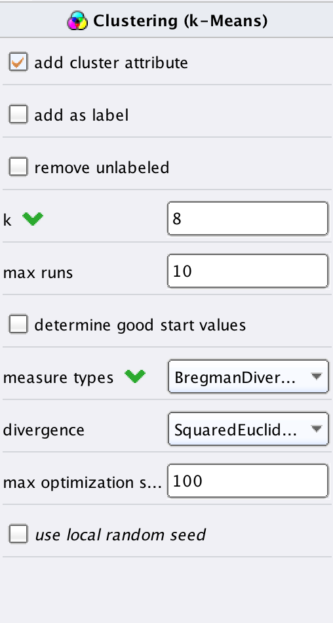
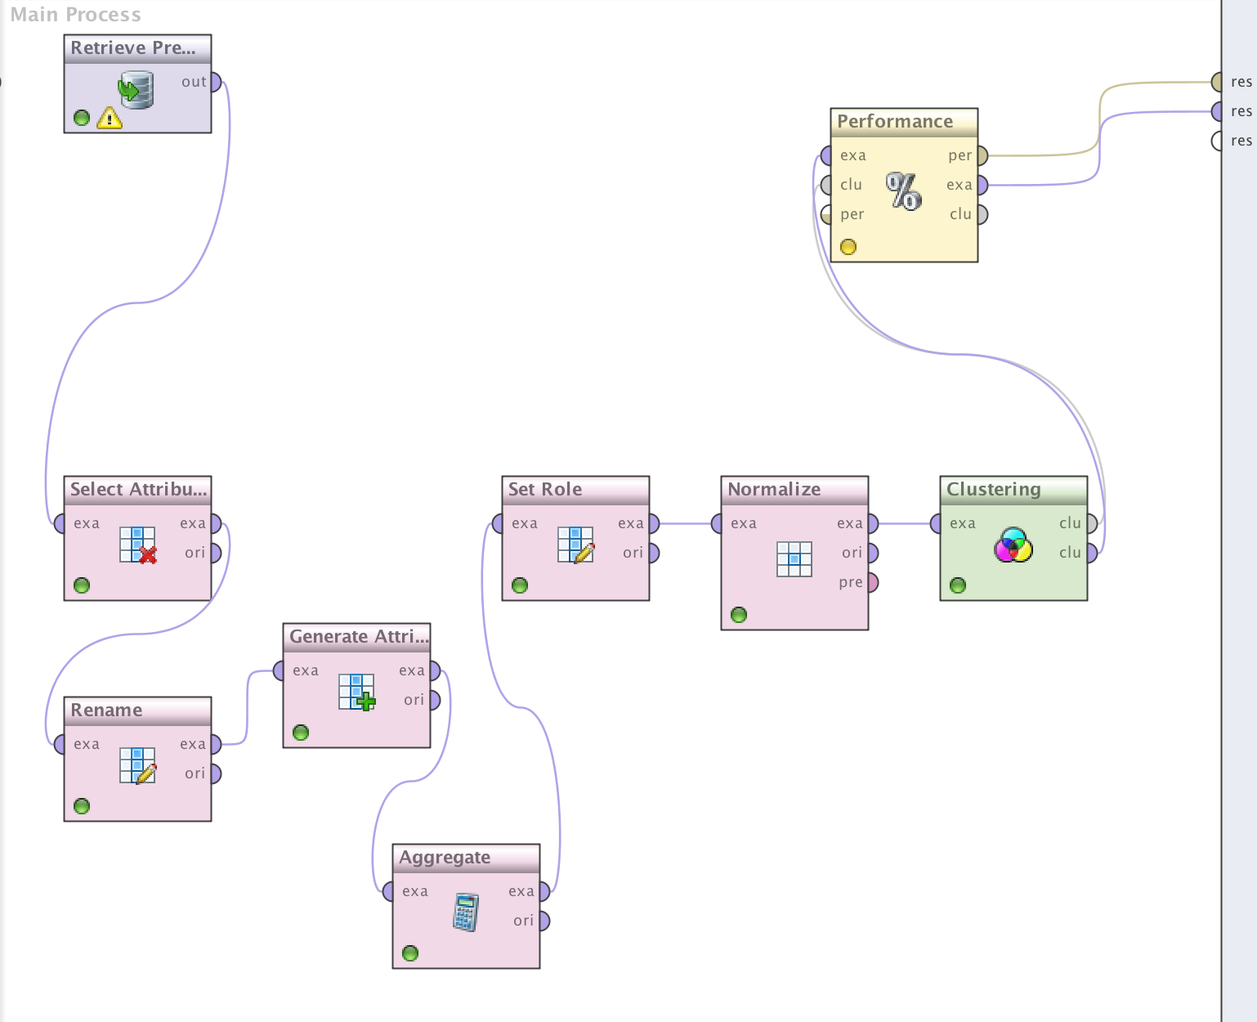
Tools
Main operator
Final process

Slide 6
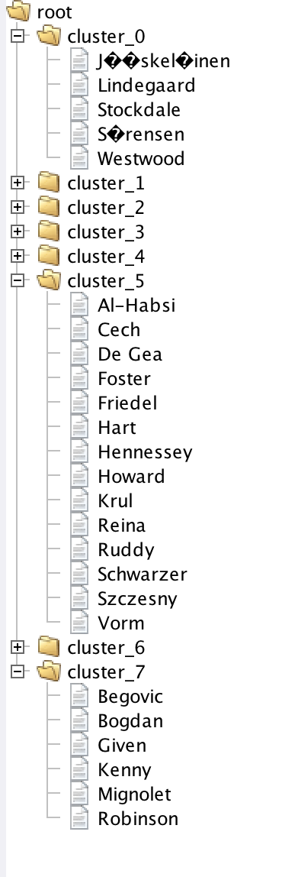
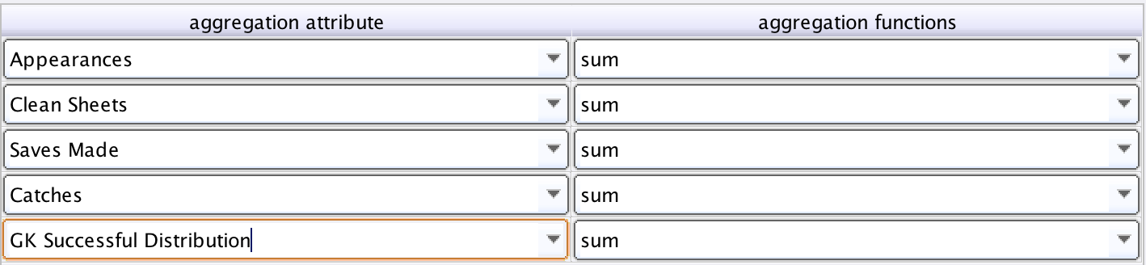
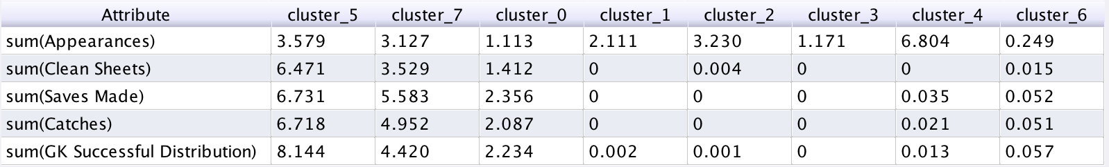
Detection
Goalkeeper
Aggregate operator
Results

Slide 7
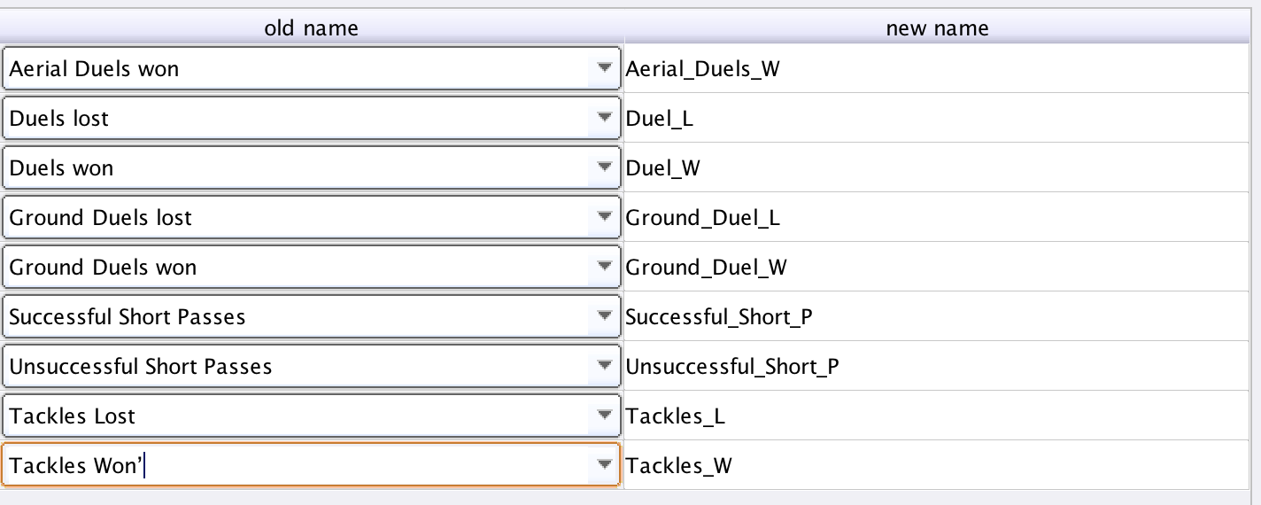
Detection
Defender
Rename Operator

Slide 8
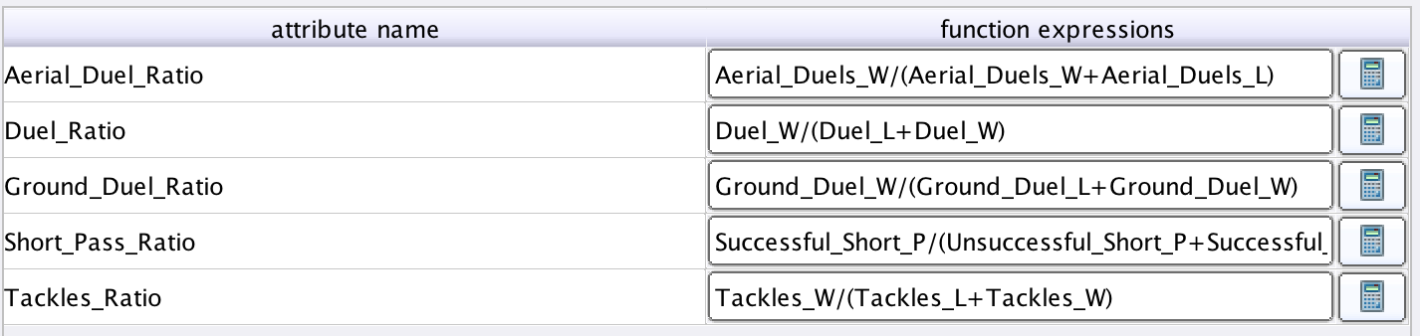
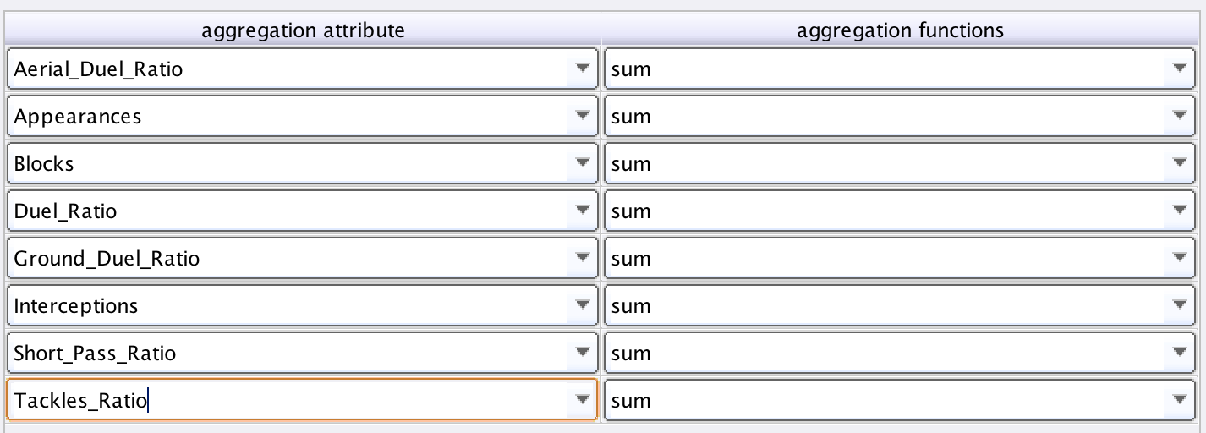
Detection
Defender
Generate Attributes operator
Aggregate operator

Slide 9
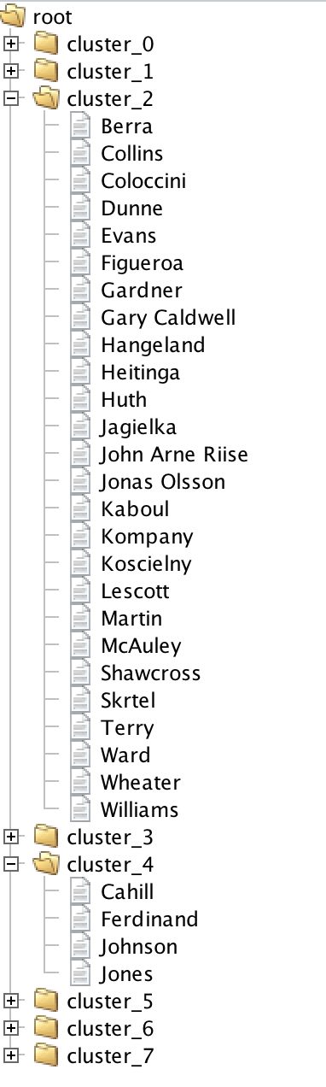
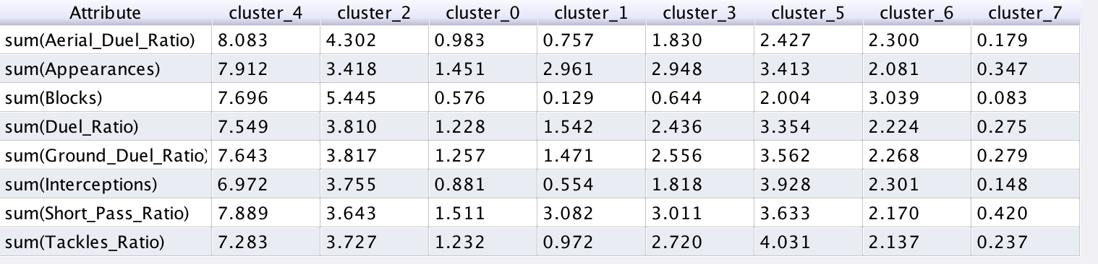
Detection
Defender
Results

Slide 10
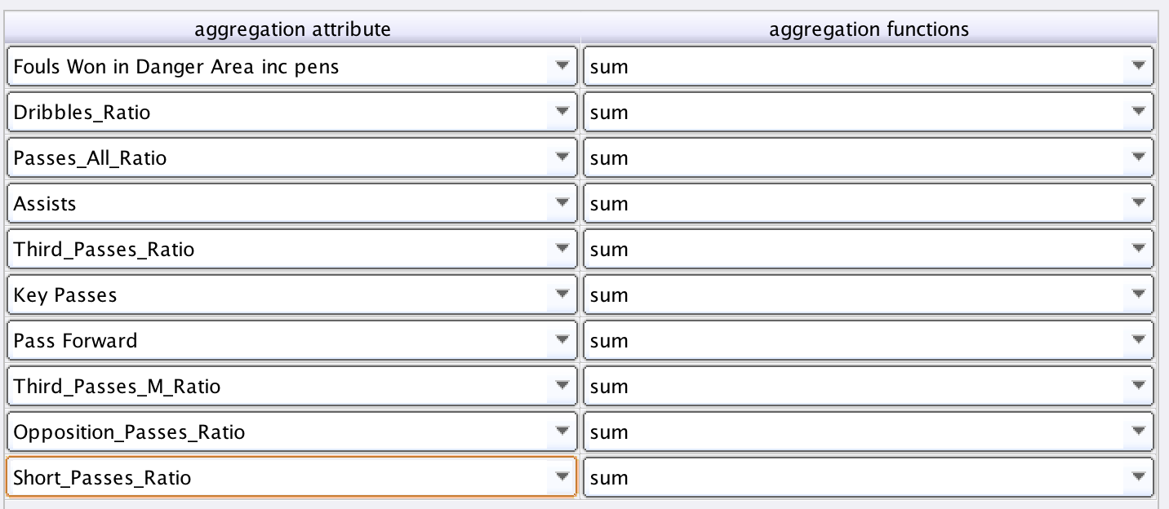
Detection
Midfielder
Aggregate operator

Slide 11
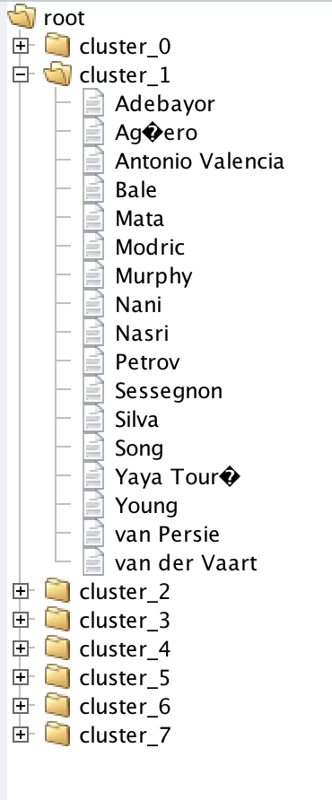
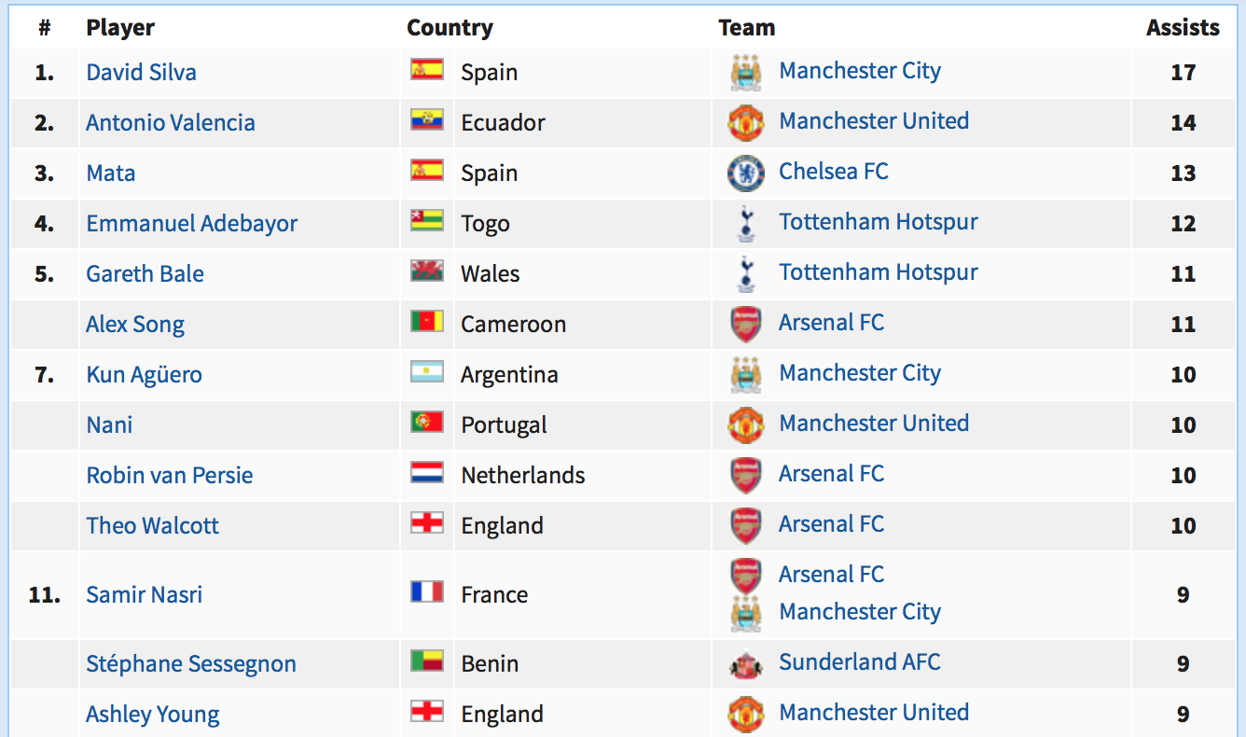
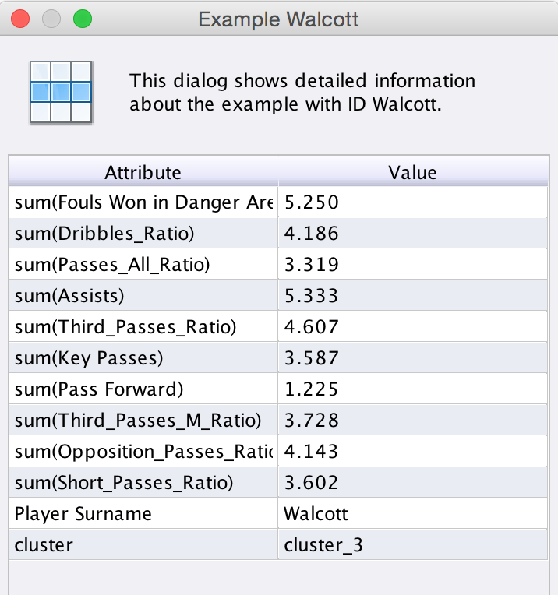
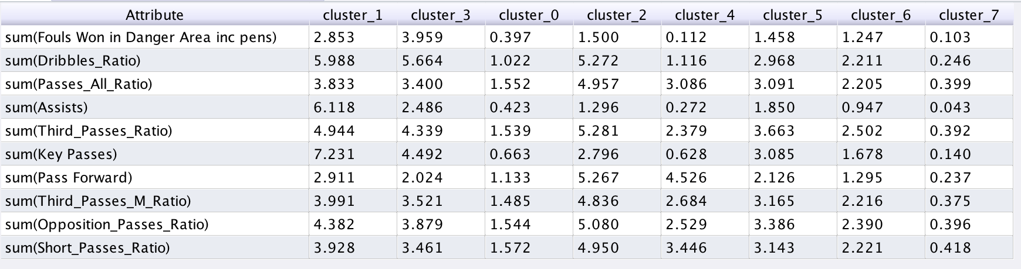
Detection
Midfielder
Results

Slide 12
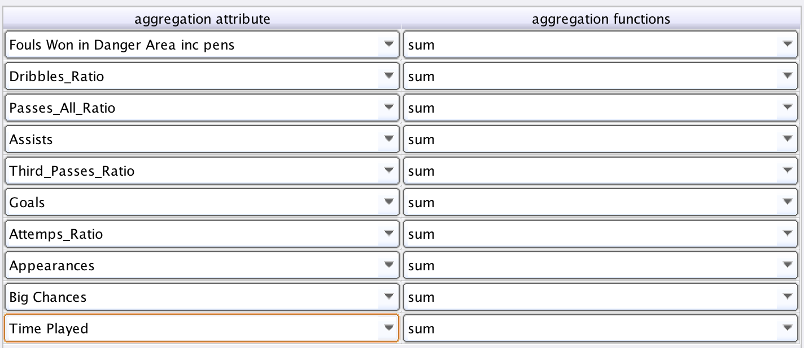
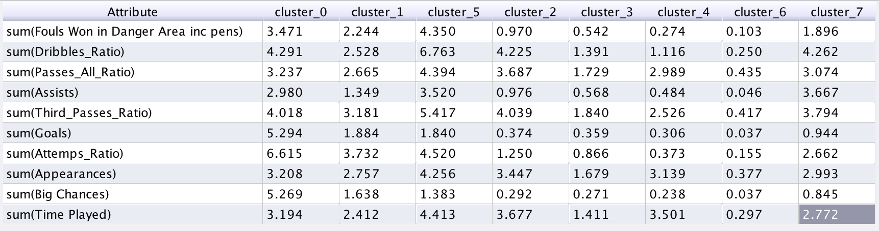
Detection
Forward
Aggregate operator
Results

Slide 13
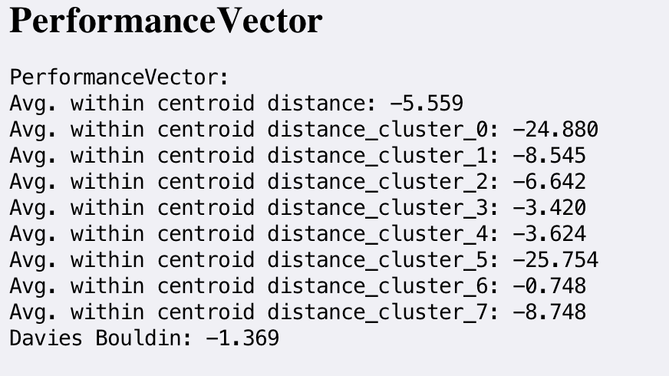
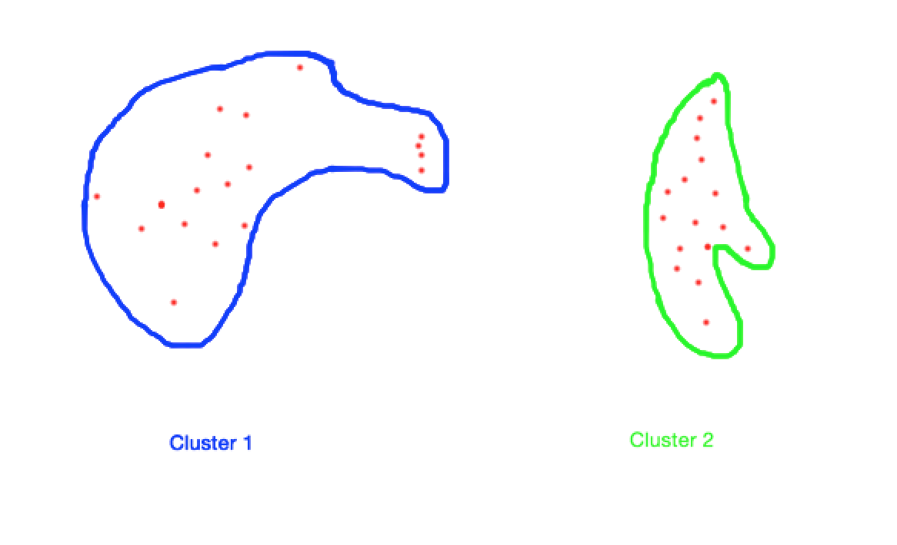
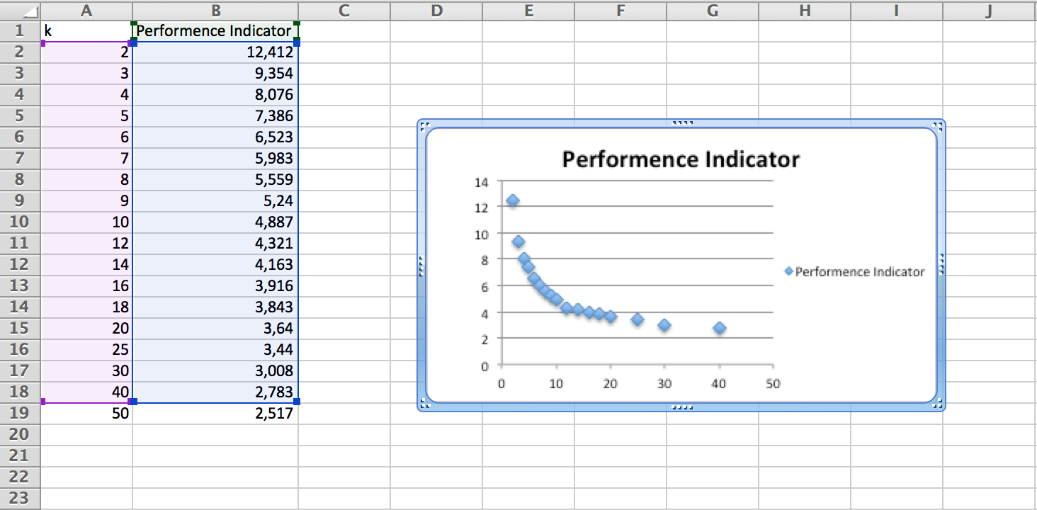
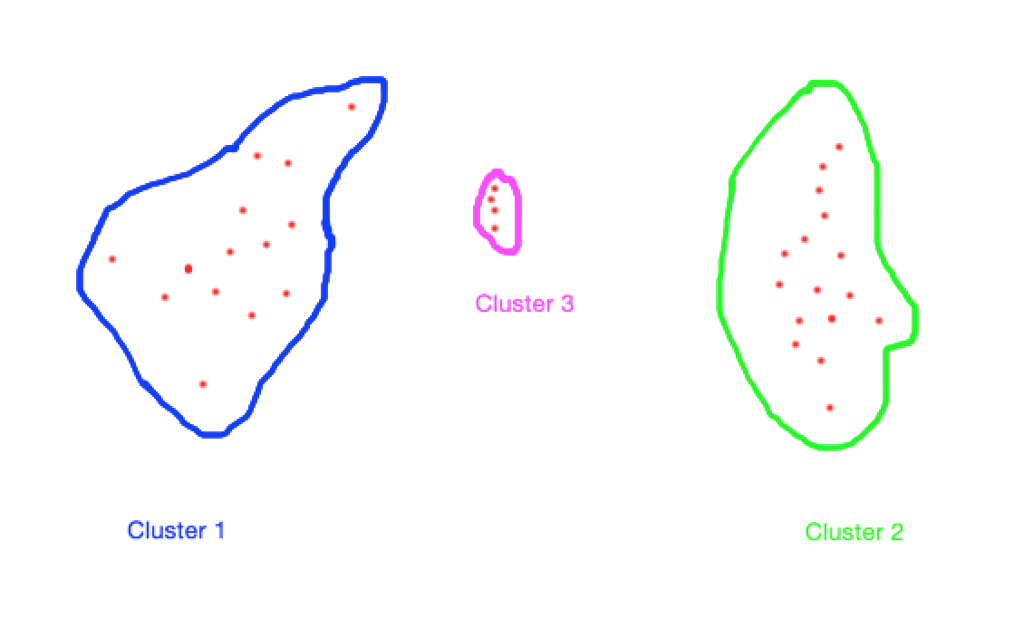
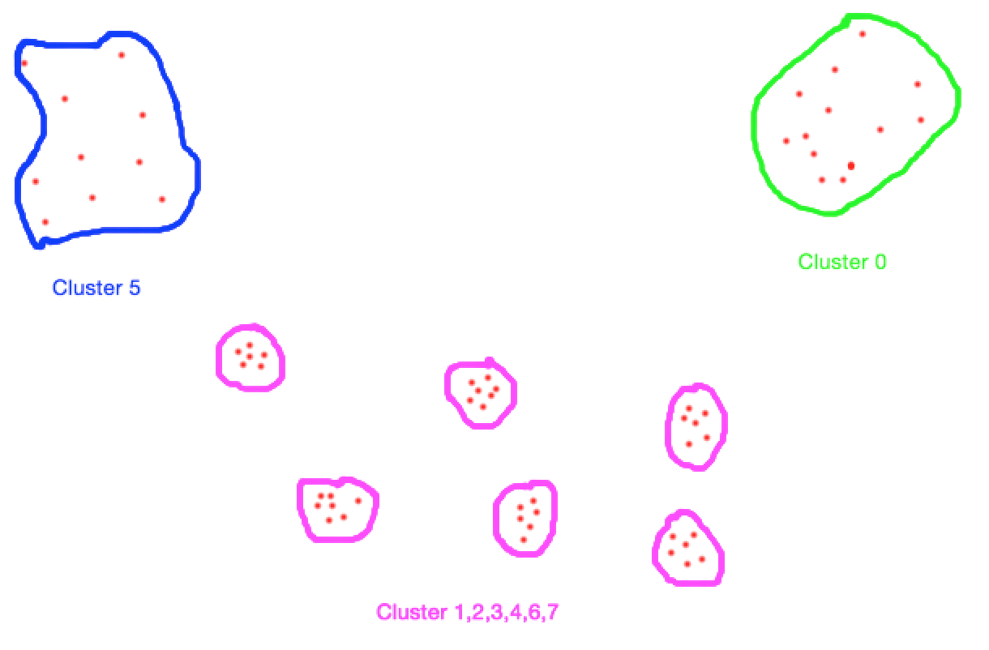
Detection
Forward
Performance operator
Solution
Representation of our clusters

